Slide 1

Project Title: Solving the 2×2×2 Rubik’s Cube with Feature-Based Reinforcement Learning
DSCI-6612-01
Intro to Artificial Intelligence
Team Members:
Stuti Bimali
Binaya Dhakal

Slide 2
Goals and Techniques
Goal:
compare the effectiveness of model-free reinforcement learning algorithms—Q-Learning, Policy Gradient, and PPO—in solving the 2x2 Rubik's Cube,
Evaluating their learning speed, stability, and success rate
Training agents to solve the cube via trial and error.
Techniques Used:
Q-Learning
Policy Gradient (REINFORCE)
PPO (Proximal Policy Optimization)

Slide 3
Who Covers What?
Stuti: Environment + Q-Learning agent
Binaya: Policy Gradient, PPO, Evaluation + Analysis

Slide 4

Let’s Begin
Running run_all.py to train and evaluate all agents
Real-time terminal output and performance tracking

Slide 5
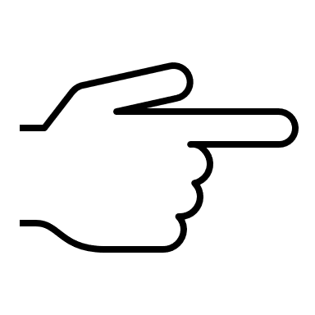
Demo
https://www.youtube.com/watch?v=_tpJyvdk4J4

Slide 6

Policy Gradient
In contrast to Q-learning –which learns how good each actions in a given state, Policy Gradient methods learn a policy directly.
Policy -> Function that maps states to a probability distribution.
Learning Objective -> Adjust policy parameters to maximize expected reward over time.
Notes:
PPO is a Model free RL algorithm that uses clipped objective to prevent overly large policy updates. Instead of maximizing the reward by raw policy gradient, PPO clips the size of an update to ensure the new policy doesn't deviate too much from the old one. This makes learning more stable and efficent. It uses the Actor-Critic architecture which we will see in the code itself.

Slide 7
Proximal Policy Optimization
PPO -> Model-free RL algorithm that uses a clipped objective to prevent overly large policy updates.
Policy Gradient updates policy using entire episodes -> can suffer higher variance.
PPO improves on this by making smaller, more controlled updates to the policy
Uses Actor – Critic Architecture
Notes:
PPO is a Model free RL algorithm that uses clipped objective to prevent overly large policy updates. Instead of maximizing the reward by raw policy gradient, PPO clips the size of an update to ensure the new policy doesn't deviate too much from the old one. This makes learning more stable and efficent. It uses the Actor-Critic architecture which we will see in the code itself.

Slide 8
Thank you

